Slide 1
HUMAN ACTIVITY RECOGNITION USING SMARTPHONES
Team Members:
G.V.V. Lalith Krishna (22501A0563)
G. Saethu Sai (22501A0561)
G. Devi Priya Anjali (22501A0558)
A. Sai Anil Kumar (22501A0516)

Slide 2
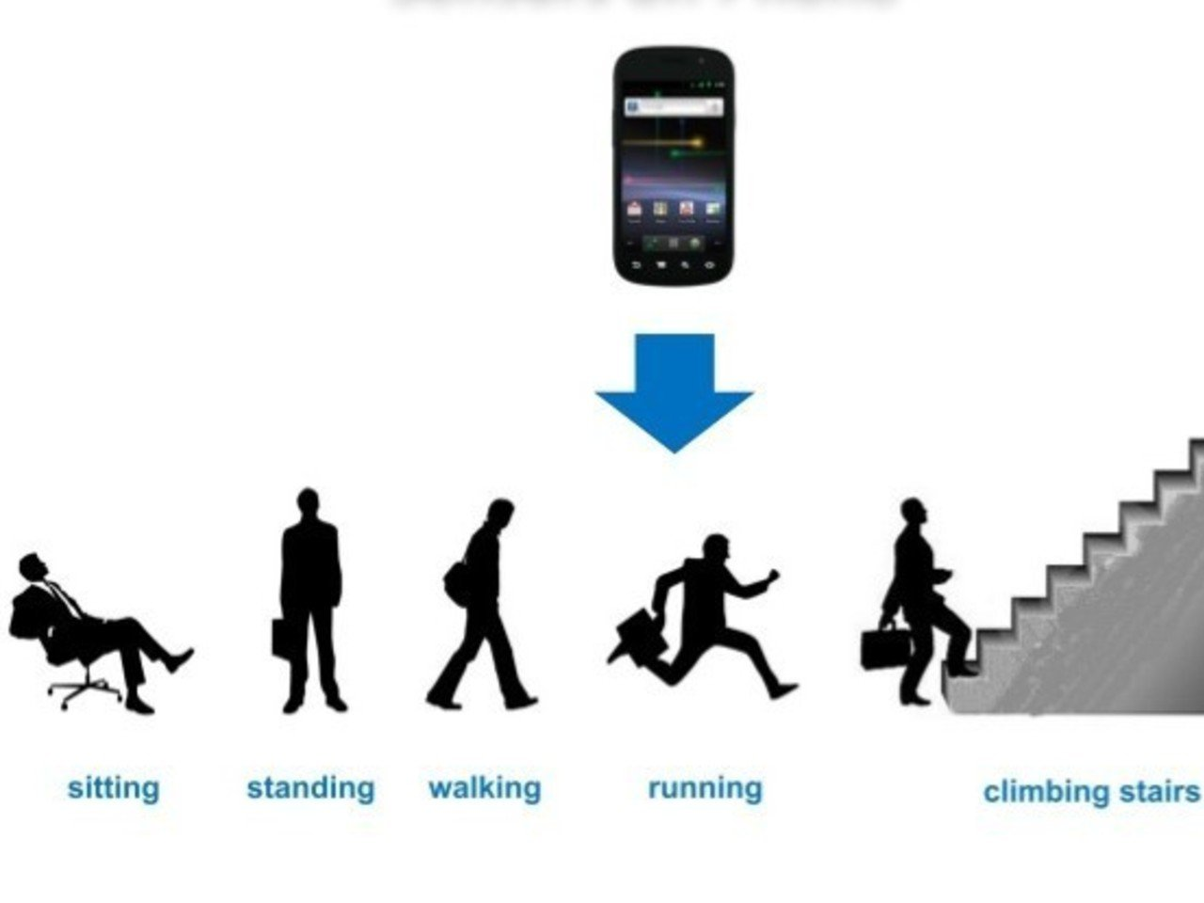
ABSTARCT
Human Activity Recognition (HAR) is a machine learning-driven approach to identifying human movements using sensor . It plays a vital role in healthcare, fitness tracking, smart environments, and surveillance. This project focuses on developing an accurate HAR model by preprocessing sensor data and applying classification techniques. The goal is to enhance real-time activity detection for practical applications in smart wearables and IoT systems.

Slide 3
PROBLEM STATEMENT
The rise of smartphones equipped with motion sensors like accelerometers and gyroscopes presents an opportunity for intelligent Human Activity Recognition (HAR) systems. Accurately recognizing human activities is a challenging task due to variations in movement patterns, environmental factors, and sensor noise. Traditional methods struggle with real-time classification and adaptability to diverse activities. This project aims to develop a machine learning-based Human Activity Recognition (HAR) system that improves accuracy, efficiency, and robustness, enabling better applications in healthcare, fitness tracking, and smart environments.

Slide 4
OBJECTIVES
The goal of this project is to build an efficient Human Activity Recognition (HAR) system using machine learning .It aims to
Accurately classify human activities: Develop a model that effectively identifies activities like walking, running, sitting, and standing based on sensor or video data.
Improve recognition using machine learning techniques: Utilize advanced algorithms to enhance accuracy, reduce misclassification, and adapt to different environments.
Develop a system that can be integrated into smart devices: Ensure the model is lightweight and efficient for real-time implementation in wearables, IoT systems, and healthcare applications.

Slide 5
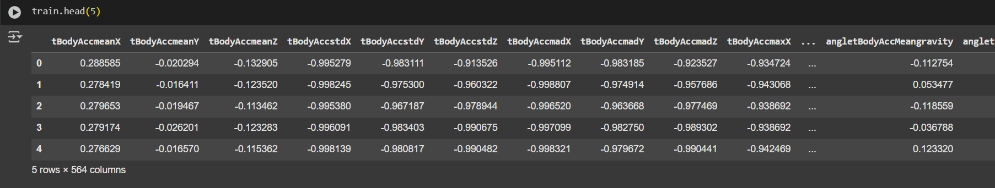
Dataset Used
This project utilizes the UCI Human Activity Recognition (HAR) Dataset, which contains sensor data from smartphone accelerometers and gyroscopes. The dataset includes recordings of six activities: walking, walking upstairs, walking downstairs, sitting, standing, and lying down. Key features extracted include time-domain and frequency-domain attributes such as mean, standard deviation, and signal magnitude, which help in accurately classifying human movements.
Dataset Link:https://archive.ics.uci.edu/dataset/240/human+activity+recognition+using+smartphones
Dataset shape: train and test shape ( (7352, 564) (2947, 564))

Slide 6
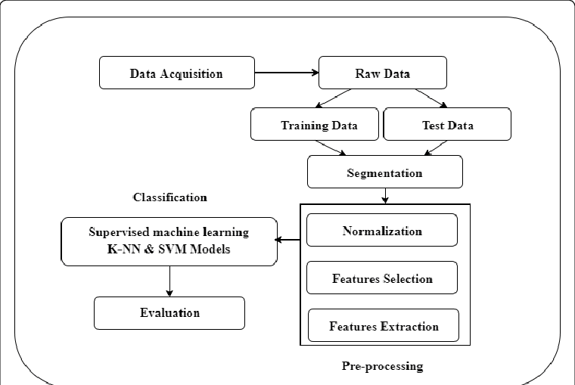
Methodology
This project employs a sensor-based approach using accelerometer and gyroscope data for activity classification. The methodology involves:
Data Preprocessing – Cleaning, normalization, and feature extraction (e.g., mean, standard deviation, and signal magnitude).
Model Selection – Using supervised learning algorithms such as Random Forest, Support Vector Machine (SVM), Decision Tree, and K-Nearest Neighbors (KNN) for classification.
Training & Evaluation – Models are trained on labeled data and evaluated using accuracy, precision, recall, and F1-score to determine the best-performing classifier.

Slide 7
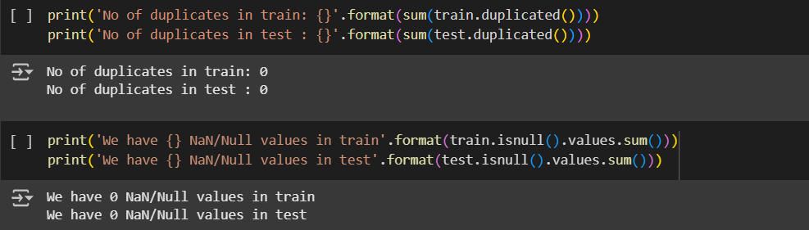
Data PREPROCESSING
Data preprocessing is a crucial step to ensure the quality and reliability of the HAR model. The process includes:
Cleaning and Handling Missing Values: Removing or imputing missing or noisy sensor readings to maintain data integrity.
Feature Extraction Techniques: Extracting meaningful features like mean, standard deviation, energy, and signal magnitude area (SMA) from raw sensor data.
Normalization and Transformation: Scaling features using techniques like Min-Max normalization or Z-score standardization to ensure uniform input for machine learning models.

Slide 8
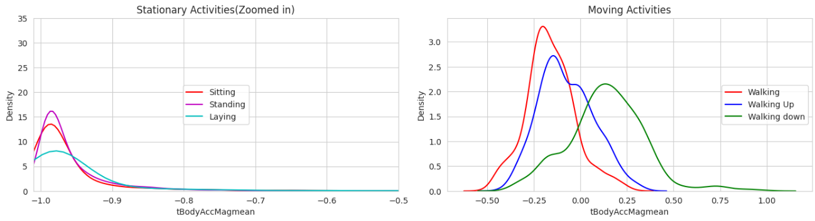
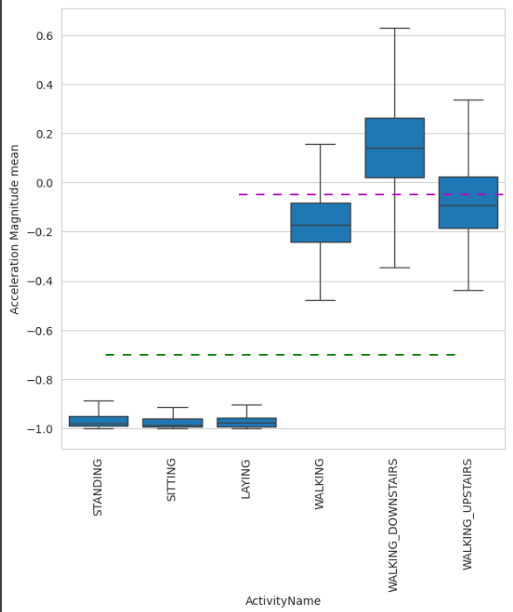
Fig-1
Observations:
Fig-1 : Stationary and Moving activities are completely different
Fig-2:If tAccMean is < -0.8 then the Activities are either Standing or Sitting or Laying.
If tAccMean is > -0.6 then the Activities are either Walking or WalkingDownstairs or WalkingUpstairs.
If tAccMean > 0.0 then the Activity is WalkingDownstairs.
We can classify 75% the Acitivity labels with some errors.
Fig-2

Slide 9
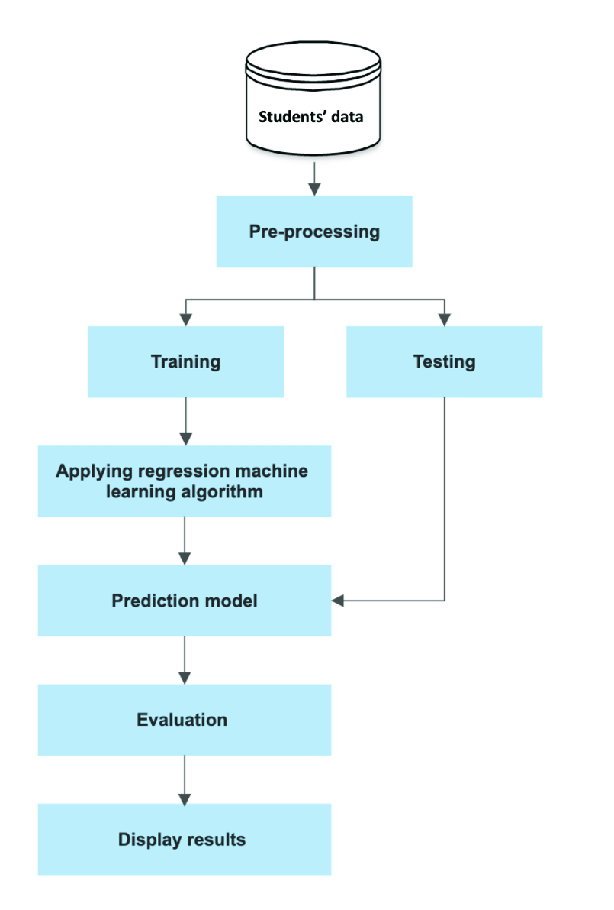
Model Selection and Training
The project uses supervised machine learning algorithms to classify human activities.
Algorithms Used: Logistic Regression , Support Vector Machine (SVM), and K-Nearest Neighbors (KNN) were chosen for their effectiveness in classification tasks.
Training Process: The dataset was split into training and testing sets. Models were trained on the labeled training data and evaluated on the test set.
Evaluation Metrics: Accuracy, precision, recall, and F1-score were used to measure performance.

Slide 10
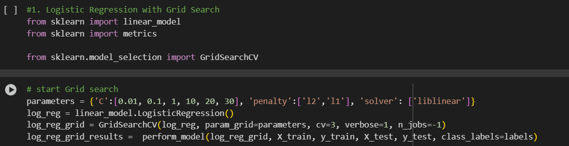
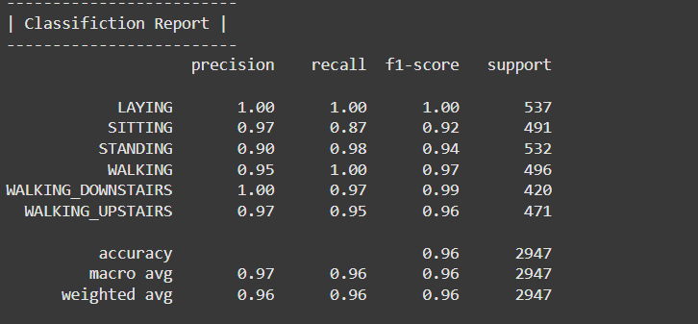
LOGISTIC REGRESSION
Logistic Regression is a supervised machine learning algorithm used for binary or multiclass classification tasks. In the context of this project, it is used to classify human activities based on sensor data (accelerometer and gyroscope readings). Logistic Regression models the relationship between the input features and the probability of a particular activity occurring, outputting the likelihood of each activity class (e.g., walking, sitting, running). It is simple, efficient, and effective for tasks where the classes are linearly separable.

Slide 11
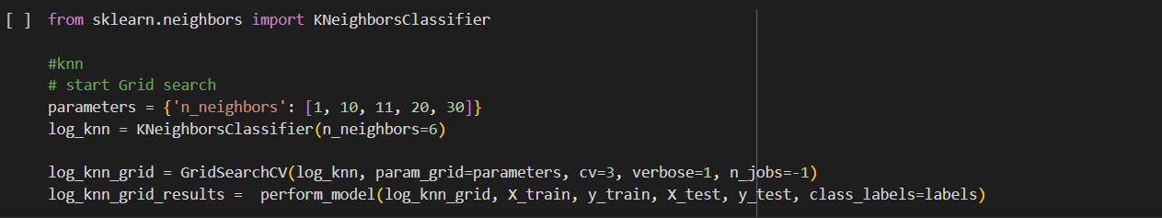
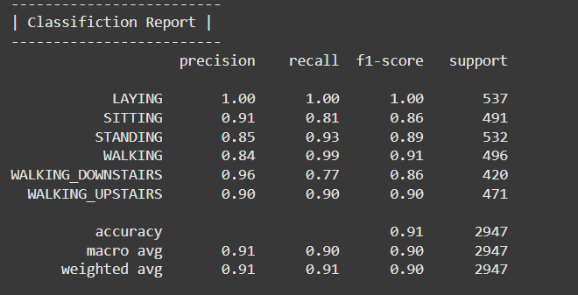
K-Nearest Neighbors (KNN)
K-Nearest Neighbors (KNN) is a supervised machine learning algorithm used for classification tasks. In this project, KNN is applied to classify human activities based on sensor data (accelerometer and gyroscope readings). The algorithm works by identifying the 'K' closest data points (neighbors) in the training set and assigning the most common activity class among them to the test data. KNN is simple to implement, requires no training phase, and performs well in activity recognition when the data is well-defined and the classes are distinct.

Slide 12
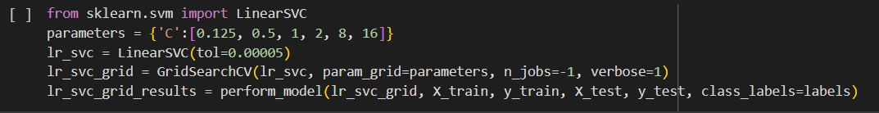
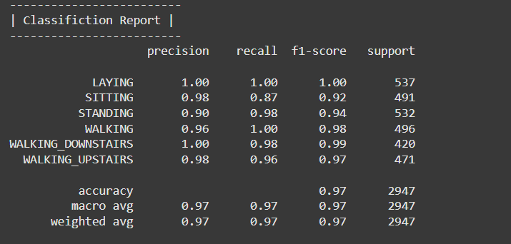
SUPPORT VECTOR MACHINES (SVM)
Support Vector Machine (SVM) is a supervised machine learning algorithm used for classification tasks. In this project, SVM is applied to classify human activities based on sensor data (accelerometer and gyroscope readings). The algorithm works by finding the optimal hyperplane that separates different activity classes in the feature space. SVM can handle both linear and non-linear classification by using kernel functions, making it effective for complex activity recognition tasks. It performs well when there is a clear margin of separation between activity classes and can handle high-dimensional data efficiently.

Slide 13
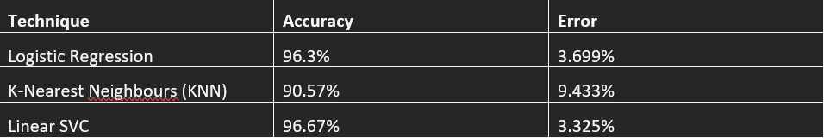
COMPARISON OF 3 MODELS :
While SVM performs best in terms of accuracy for complex, high-dimensional data, KNN is simple and effective for smaller datasets with clear class boundaries. Logistic Regression serves as a strong baseline but may struggle with non-linear activity patterns. The choice of model depends on dataset characteristics, computational resources, and the required classification performance.

Slide 14
CONCLUSION & FUTURE SCOPE
This project successfully implemented and compared three supervised machine learning models—K-Nearest Neighbors (KNN), Support Vector Machine (SVM), and Logistic Regression—for Human Activity Recognition (HAR) using sensor data (accelerometer and gyroscope readings). Each model demonstrated distinct strengths: KNN for simplicity and interpretability, SVM for handling complex, high-dimensional data, and Logistic Regression for fast, probabilistic classification. The models performed well in classifying common human activities such as walking, running, and sitting, proving the potential of sensor-based activity recognition.
Future Scope:
Real-Time Activity Recognition
Implement the model in a mobile app for live activity tracking, allowing users to monitor their activities in real time.
Integration with IoT & Wearable Devices: Extend the system to smartwatches and fitness bands for continuous activity tracking.
Enhance healthcare applications by incorporating activity recognition for better health monitoring, fall detection, and elderly care.
Activity Prediction & Anomaly Detection :Extend the system to predict future activities based on behavior patterns.
Detect abnormal activities for security and healthcare applications (e.g., fall detection for elderly monitoring).

Slide 15


